Slide 1
Spring MVC, Validation, REST
Junior Training Program
Janos Biro
Notes:
ET: (exercise together, examining API, doing a coding example together)
EA: (exercise to be done individually)
Other notes: reminders for the presentator
Preparation:
Create your own repository at gitbud
Name cards
Commits to save the day (help): checkout if the presenter stuck, or copy snippets from it (do not show to pupils)
https://gitbud.epam.com/janos_biro/spring-aop-training/commits/master
BUT the presentation should be dynamic, create a new gibud repo at the start of each training, commit continously and share the hascode if something went wrong (also solve the EAs)
You can always choose other ETs and EAs, but try to follow them (so that you can use your help (see above))
EAs here are examples, help does not include them
„ET” without any notes means that the code on the slide must be typed in together

Slide 2
Preparation
Install Notepad++
  http://notepad-plus-plus.org/download/v6.5.4.html
Install GIT 1.8.X
  http://git-scm.com/download/win
Create your own GITBUD repo
  https://gitbud.epam.com

Slide 3
Preparation
Install JDK 7
  http://www.oracle.com/technetwork/java/javase/downloads/jdk7-downloads-1880260.html
  JAVA_HOME, PATH, never use „Program Files”
Install STS 3.4 RELEASE
  http://download.springsource.com/release/STS/3.4.0/dist/e4.3/spring-tool-suite-3.4.0.RELEASE-e4.3.1-win32-x86_64.zip
Install Tomcat 7.0.x (Web Container)
  http://xenia.sote.hu/ftp/mirrors/www.apache.org/tomcat/tomcat-7/v7.0.52/bin/apache-tomcat-7.0.52-windows-x64.zip
Notes:
Install from ZIP!
Overview of versions:
http://tomcat.apache.org/whichversion.html
We write Servlet 3.0 web.xml-s but features new to Servlet 3.0 are discussed separately
http://publib.boulder.ibm.com/infocenter/ieduasst/v1r1m0/index.jsp?topic=/com.ibm.iea.was_v8/was/8.0/ProgramingModel/WASV8_Servlet_JSP_EL/player.html

Slide 4
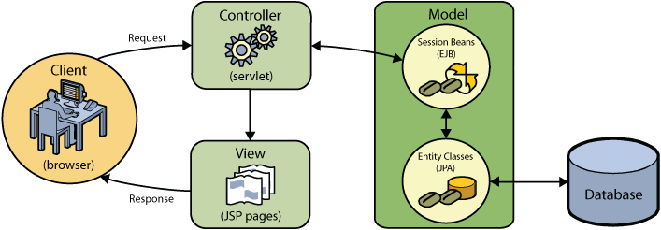
MVC pattern – with Java EE technologies

Slide 5
MVC pattern
Separate
  Presentation (or View)
    HTML, JSON, PDF, etc.
  Model
    Data (from DB, Webservice, etc.)
    Business logic (actions on that data)
Controller is to (coordinate)
  Understand what is requested
  Ask to Model to do the work and get the results
  Give the result to the Presentation

Slide 6
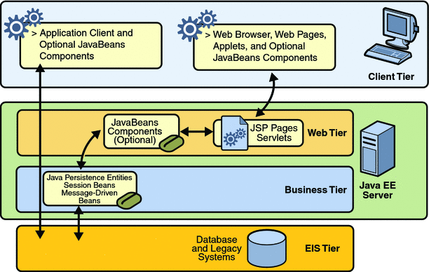
Java EE tiered application model
Notes:
Without an Application server we do not have Business tier, only simple components (JavaBeans or just POJOs)

Slide 7
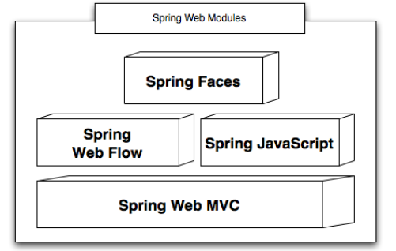
Spring Web Modules
Built upon Servlet API (Web tier)
Notes:
So it needs a Web Container

Slide 8
Spring Web Modules
Spring MVC
  Spring’s MVC framework
    optional module
    uses Spring configuration
    similar to Struts 1.x
  Builds on the Servlet API
    and also hides it, you’ll never use Servlets directly
    a portlet version is also available in parallel
  The core platform for developing web application in Spring
    All higher level modules build on it

Slide 9
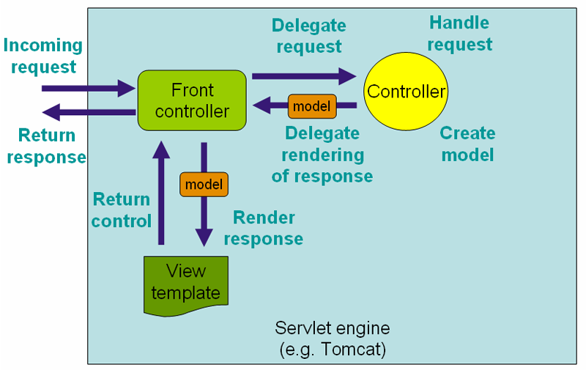
Front controller pattern
Notes:
The front controller is a servlet
Controllers are Spring Beans

Slide 10
Spring MVC
Out-of-the-box supported view technologies
  JSP & JSTL
  JSON
  Atom & RSS feeds
  XML
  Apache Tiles
  Velocity & Freemarker
  XSLT
  PDF/Excel
  JasperReports (Open source reporting framework)

Slide 11
Spring Web Modules
Spring WebFlow
  plugs into Spring Web MVC as a Controller technology for implementing stateful “flows”
  raises the abstraction level by providing a dedicated flow definition language (DSL)
  Flows model stateful operations that take a series of requests to complete
  NOT for simple ”single-request” operations

Slide 12
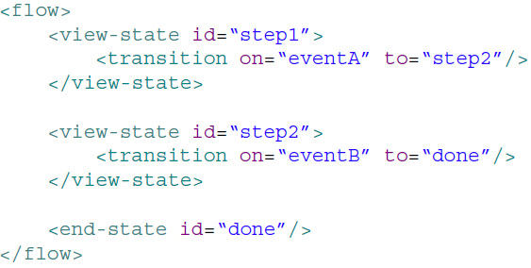
Spring Web Modules
Spring WebFlow

Slide 13
Spring Web Modules
Spring JavaScript
  JavaScript abstraction framework
  included in Web Flow 2
  builds on Dojo, other implementations possible
  rarely used because the world goes another direction (Angular.js, Backbone.js, etc.)
  out of scope of this book

Slide 14
Spring Web Modules
Spring Java Faces
  Combines the JSF UI component model with Web Flow navigation/state management
    All in a native Spring MVC environment
  built on Spring JavaScript
  includes a lightweight JSF component library
  rarely used (JSF itself is rarely used)

Slide 15
Empty Spring MVC application
New/Spring project/Spring MVC project
Examine and adjust pom file, leave only the neccessary things there
  find out based on previous training sessions
Examine all the created files
Set the web.xml to support Servlet 3.0
Notes:
407c40a93 Empty Spring MVC application
463cbe6f3 Cleaning it up

Slide 16
If you are lost… a hashcode can save the day!
Web App of The Next Omen
git@gitbud.epam.com:janos_biro/spring-mvc-training-[X].git
git clone git@gitbud.epam.com:janos_biro/spring-mvc-training-[X].git
git checkout [hashcode]

Slide 17
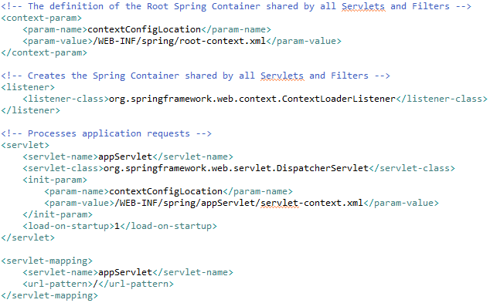
Spring MVC demystified
Notes:
We are still a web app
A listener to load the root context
A dispatcher servlet (front controller)
Loaded first
It is default servlet! (= it handles even the requests for static resources!)

Slide 18
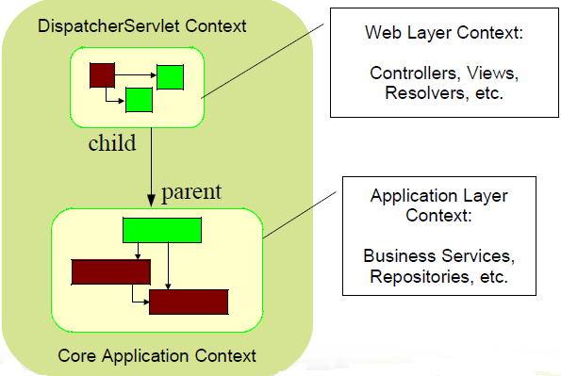
Context hierarchy
Notes:
Core is stored in ServletContext under a special name!
The other context is NOT accessible this way
Both has type WebApplicationContext
ET:
List all the ServletContext objects and find out!

Slide 19
Context hierarchy
WebApplication context
  knows ServletContext
  local and theme resolution upport
  has special beans (with sensible default)
    HandlerMapping (most popular is the annotation driven)
    HandlerExceptionResolver
    ViewResolver
    LocaleResolver
    ThemeResolver
    MultipartResolver (file upload support)
    FlashMapManager (flash attribute support)
Notes:
Core is stored in ServletContext under a special name!
The other context is NOT accessible this way
Both has type WebApplicationContext
ET:
List all the ServletContext objects and find out! (here we can add a debug tag file)
Default: /org/springframework/web/servlet/DispatcherServlet.properties (in the spring mvc jar)

Slide 20
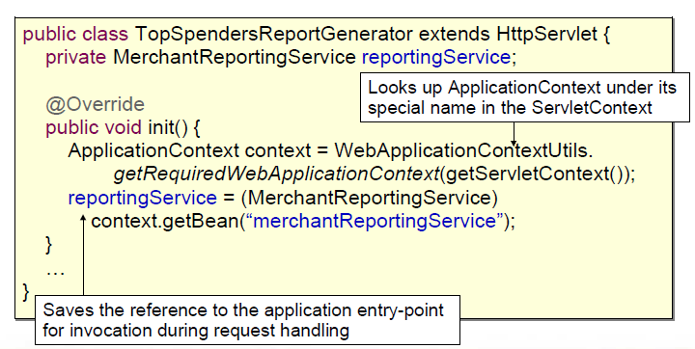
Access from a pure Servlet
If you want Spring, but not Spring MVC
Notes:
WebApplicationContextUtils
– static helper
– provides access to the Spring Application Context

Slide 21
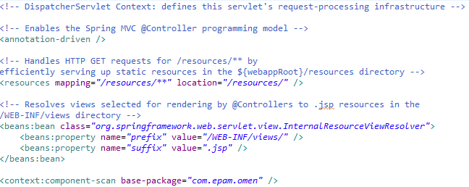
Spring MVC demystified

Slide 22
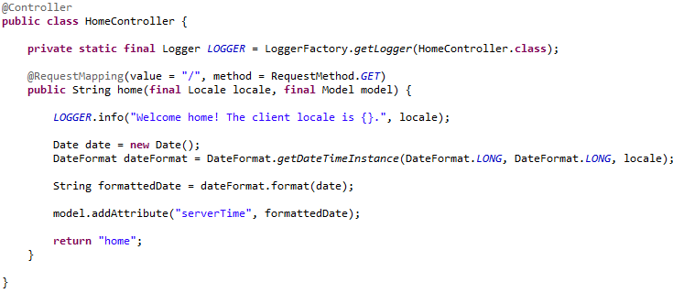
Spring MVC demystified
Notes:
Talk about every line, start with @Controller which is a @Component

Slide 23
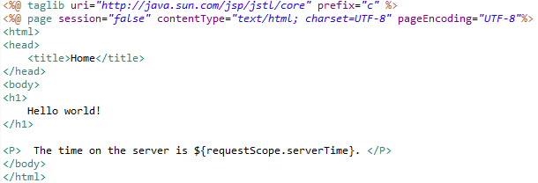
Spring MVC demystified

Slide 24
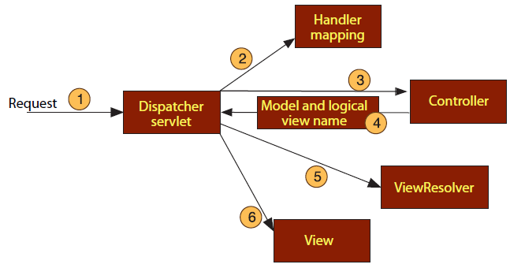
Spring MVC essence

Slide 25
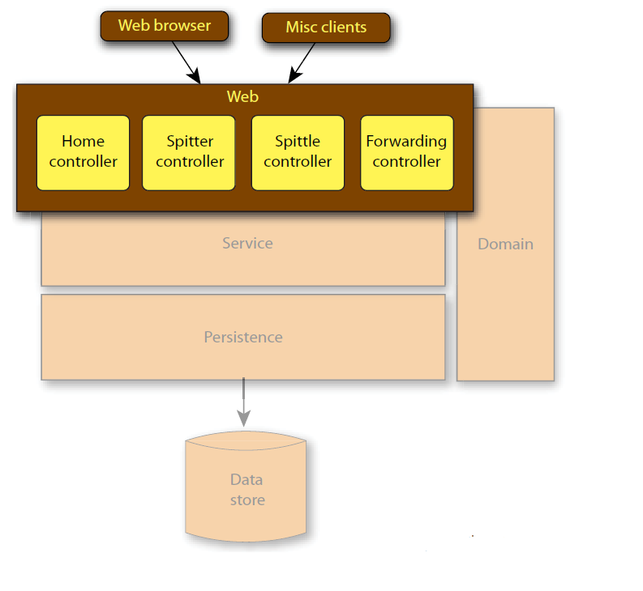
Typical MVC based design

Slide 26
Spring MVC flavours
Spring <MVC />
  relies on solely XML configuration
  allows centralized configuration of controllers
Spring @MVC (since Spring 2.5)
  simplied, annotation based programming model for controllers
  in-place configuration of controllers
  enabled by <annotation-driven />
  more static components (e.g. view resolvers) of Spring MVC are still configured in XML
Java config
  Enabled by @EnableWebMvc on a @Configuration object
Spring @MVC is preferred by most projects

Slide 27
South Park to Omen
Tranform the South Park index page to Spring MVC application
Notes:
ET
Make it „Omen”
Create debug tag and search the root context loaded by Spring
e573244ed Omen index page (transformed from South Park), debug tag

Slide 28
Spring MVC vs. pure Servlets
All Spring features plus…
  Clearer MVC separation
  Flexible configuration, more extension points
  Flexible model transfer
  Locale and theme resolution
  JSP tag library (forms, error handling and more)
  Beans scoped to request, session
Notes:
Why do we need it?

Slide 29
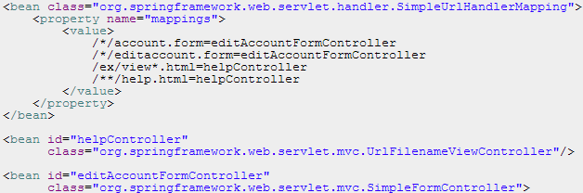
HandlerMapping
Used by the dispatcher to find the appropriate handlers (controllers) for an URL
Notes:
/org/springframework/web/servlet/DispatcherServlet.properties
Default is great for us! (which handles annotations)
HandlerAdapter is used by handler mapping, forget it

Slide 30

Controllers
@Controller
  to define controllers for the dispatcher
  POJO – easy to unit test
  @Component

Slide 31
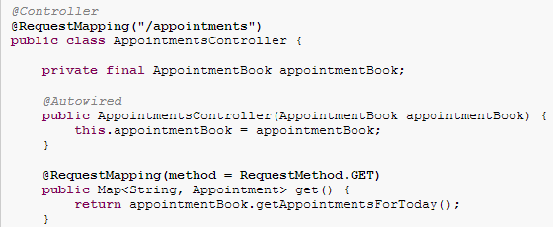
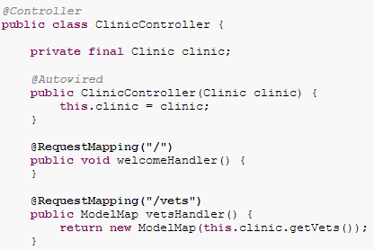
Controllers
@RequestMapping
  to map an URL+HTTP method to a handler class or method

Slide 32
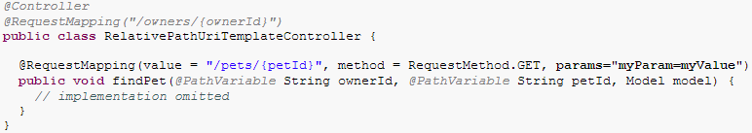
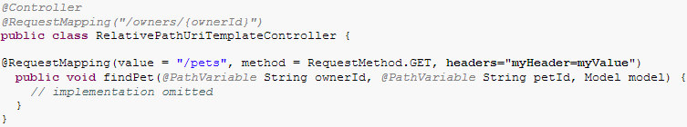
Controllers
@RequestMapping – parameters, headers
Notes:
Narrowing the match
Value is not neccessary
Params: GET/POST/etc are supported

Slide 33


Controllers
@RequestMapping – consumes/produces
  „consumes” checks the „Content-Type” request header
  „produces” checks the „Accept” request header
Notes:
Narrowing the match
- „text/*” style wildcards supported
- „!” style negation supported

Slide 34
Controllers
@RequestMapping – method parameters
  handler methods can have VERY flexible signatures
  the Spring (HandlerMapping classes) injects the appropriate objects based on their types
  the order of the parameters is undefined except the one BindingResult

Slide 35
Controllers
@RequestMapping – method parameters
  Servlet API
    HttpServletRequest, HttpSession, Reader/Writer
  Locale (based on LocaleResolver, see later)
  @PathVariable, @MatrixVariable, @RequestParam, @RequestHeader, @CookieValue, @RequestBody, @ResponseBody,
Notes:
http://docs.spring.io/spring/docs/3.2.8.RELEASE/spring-framework-reference/html/mvc.html#mvc-ann-arguments

Slide 36

Controllers
@RequestMapping – @RequestParam
  to bind request parameters to method arguments
  primitives and Strings are assigned without @RequestParam as well (NOT binding!)
  makes the parameter required by default
  supports Map<String,String>
Notes:
ET:
Create dynamic number of tabs (one per century) with the dates in tables
Copy from http://rationalwiki.org/wiki/List_of_predictions_of_the_end_of_the_world (create properties)
Configure the list of supported centuries in ServletContext
web.xml… ok but we are in spring.. ☺
org.springframework.web.context.support.ServletContextAttributeExporter + a list of numbers
Set the header to use that list in tab generation
Create a servlet which
Reads property files based on @RequestParam (use defaultValue, value, requeired attributes)
Property reading:
PropertyPlaceholder: BAD idea
org.springframework.beans.factory.config.PropertiesFactoryBean
Not dynamic
getResourceAsStream of Java… ok but we are in a webapp
ServletContext.getResourceAsStream
@Autowired ServletContext works!
ET2
Introduce a @Repository, a @Service, Event(Date, String) to make it nicer
Sort using Comparable
century is now an int in the method parameters

Slide 37
„Binding” process
performed by a WebDataBinder
  to bind request parameters and/or URI template variables to
    form object properties
  to assign values to method arguments annotated by @PathVariable, @MatrixVariable, @RequestParam, @RequestHeader, @CookieValue

Slide 38
„Binding” process
try to convert String values to objects
  PropertyEditors, Converter SPI, Formatter SPI has to be registered EXPLICITLY for WebDataBinder
    pure Spring registrations do not work!
  defaults are auto-registered but can be customized
results in
  converted object
  BindingResult object with the conversion result (errors)

Slide 39
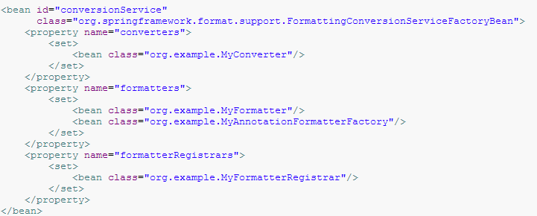
„Binding” process
Customization
Notes:
Explain Converters/Formatters
Formatter can be used with annotations as well (not covered)

Slide 40
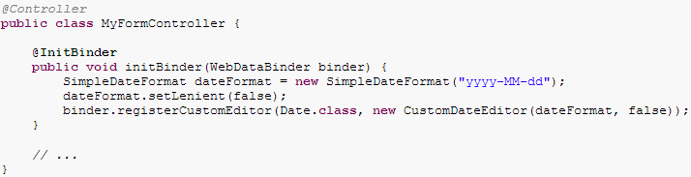
„Binding” process
Customization
Notes:
Supports @RequestMapping method arguments
ET:
Make a new tab show the very next EOW, considering a Date request param
in URL there can be a special date format (like 2010.10.10, which is not handled by the default converters)
write a PropertyEditor, a Formatter and a Converter, examine what happens

Slide 41
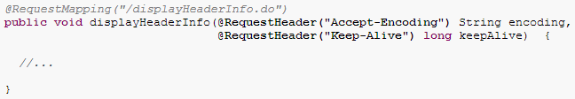
Controllers
@RequestHeader
    to bind request headers to method arguments
Notes:
Yes, so, it can be assigned to a Person if you want.. ☺

Slide 42

Controllers
@CookieValue
  to bind cookie values to method arguments
Notes:
Yes, so, it can be assigned to a Person if you want.. ☺

Slide 43
Controllers
@RequestMapping – method parameters
  form (a.k.a. command) objects
  (ANY not-recognized-as-special objects)
    binding of request parameters and URI template variables to object properties
    added to the Model with class name as key or as specified by @ModelAttribute
Notes:
http://docs.spring.io/spring/docs/3.2.8.RELEASE/spring-framework-reference/html/mvc.html#mvc-ann-arguments
http://www.intertech.com/Blog/understanding-spring-mvc-model-and-session-attributes/

Slide 44
Controllers
@RequestMapping – method parameters
  Model (java.util.Map/org.springframework.ui.Model)
    to be populated programmatically (with any object you want) and automatically (with form objects)
    model attributes are copied to the request scope after the handler method exits (per key, one-by-one)
Notes:
http://docs.spring.io/spring/docs/3.2.8.RELEASE/spring-framework-reference/html/mvc.html#mvc-ann-arguments
http://www.intertech.com/Blog/understanding-spring-mvc-model-and-session-attributes/

Slide 45
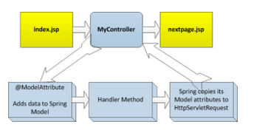
Controllers
Why do we have Model, why not use request scope directly?
Because Spring is view-agnostic!
Model attributes copied to request scope only if the given view reads from that! (JSP)

Slide 46

@SessionAttributes
to tell the Spring that which Model attributes has to be copied to the session scope as well
if a @ModelAttribute references to an attribute listed in @SessionAttributes then it must be present already
Notes:
But if you do not use @ModelAttribute then it is not required, it will be simply put to the session then
(you can use the class’s name in @SessionAttributes, but the first letter is lowercased!)

Slide 47
@SessionAttributes
Use only in a specific handler’s conversation
  typically a multi-step form processing where the actual data to be stored is gathered gradually in each step (next-next-next)
Can be deleted using
  declare SessionStatus as handler method argument
  SessionStatus.setComplete();
Can be considered as „Mini” session inside the controller
  start: put attribute(s) into the session
    manual
    automated for form objects NOT marked as @ModelAttribute(because that makes the presence neccessary) but listed in @SessionAttributes
  stop: SessionStatus.setComplete();
Notes:
ET:
Create a new tab, 3 step (+1done) EOW report
Step 1: username, email, birtdate
Step 2: evendate, title, description
Step 3: r u stupid?
Done
Use SessionAttributes, do not use ModelAttribute, do not put anything to the model manually, leverage our custom DateFormatter
Show what is in the scopes in each step
Problems:
Session attrbiute has to be cleared in at the end AND in the GET (only when a back is pressed, so when step=1)
2 GET method, with and without params=„step=1”
UTF8 form data (solved in next slide)
Back button support (we can do it manually NOW, later Spring taglib)
We must allow GET as well for step 2,3 (so that we can navigate), you can use hidden input when you post, but we have no choice when navigate back
Use <fmt:formatDate pattern="yyyy.MM.dd" value="${sessionScope.reportEOWForm.birthday}" />
Avoid resubmission (NOT NOW, redirect, but we need flash attributes, because validation result would go away)
PROBLEM: step3 can be invoked!
Use @modelattribute to force the presence of the form in the session
Put the form manually into the model in GET (the version without step param restriction)
EA:
Create storage service (any)
Create a page where it they are shown
EA:
write a filter which adds „debug=all” param to all requests
Use ServletRequestWrapper, or set use an attribute

Slide 48
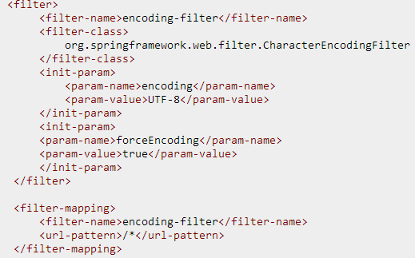
UTF-8 form data
Spring has built-in filter for this

Slide 49
Controllers
@RequestMapping – @RequestBody
  to assign request body to method parameter
  HttpMessageConverters can convert the request body to objects (String, byte[], are enabled by default)
Notes:
We do NOT discuss HttpMessageConverters any further, but only Validation&Binding of request parameters and form objects
ET/EA:
In Done screen show the request body

Slide 50

Controllers
@RequestMapping – method parameters
  BindingResult
    binding result for the preceding form object
    contains
      Binding (Converter/Formatter/PropertyEditor) errors if they throw IllegalArgumentException or ParseException
      Validation errors (see later)
  Simple types (primitives, Strings)
    see later
  etc.
    http://docs.spring.io/spring/docs/3.2.8.RELEASE/spring-framework-reference/html/mvc.html#mvc-ann-arguments
Notes:
http://docs.spring.io/spring/docs/3.2.8.RELEASE/spring-framework-reference/html/mvc.html#mvc-ann-arguments
preceding form object OR @RequestBody, but we do not care now
If BindingResult is missing there will still be a BindingResult in the request scope… BUT if a conversion error occurs → 400

Slide 51
Controllers
@RequestMapping – method parameters
  method parameters are NOT involved in the handler mapping process!
  @RequestParameter String x;
  does not mean that the container chooses a method based on a required „x” request parameter
    you can do it with a „params=x” attribute of the @RequestMapping

Slide 52
Controllers
@RequestMapping – method return types
  Model or Map
    auto-view name
      http://localhost:8080/gamecast/admin/index.html -> admin/index
  ModelAndView
    compund object
  String
    view name
  void
    indicates that the method writes the response directly
  etc.
    http://docs.spring.io/spring/docs/3.2.8.RELEASE/spring-framework-reference/html/mvc.html#mvc-ann-return-types
Notes:
http://docs.spring.io/spring/docs/3.2.8.RELEASE/spring-framework-reference/html/mvc.html#mvc-ann-return-types
Auto-view-name by RequestToViewNameTranslator
http://docs.spring.io/spring/docs/3.2.8.RELEASE/spring-framework-reference/html/mvc.html#mvc-coc-r2vnt
EA:
try all in the reportEOW example except void

Slide 53

Controllers
@RequestMapping – @ResponseBody
  to assign method return value to response body
  HttpMessageConverters can convert the return value to response body (String, byte[], are enabled by default)
Notes:
We do NOT discuss HttpMessageConverters any further, but only Validation&Binding of request parameters and form objects
ET:
Download PDF example using void return value and Outputstream (use „produces” to set contect type)
Download PDF example using @ResponseBody, byte[] return value, text/plain, 97-102 ascii codes („abcd”)

Slide 54
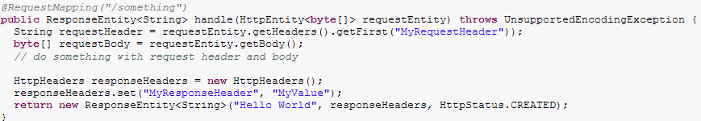
Controllers
@RequestMapping – HttpEntity
  the ultimate direct control over the request and response
  HttpMessageConverters are in use
Notes:
We do NOT discuss HttpMessageConverters any further, but only Validation&Binding of request parameters and form objects

Slide 55
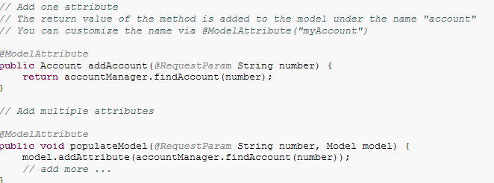
Controllers
@ModelAttribute – on non-handler methods
  all are called before all @RequestMapping methods
    if the attribute is a mini-session attribute (@SessionAttributes) then it is called only 1 time in our „mini” session
  can use the same signature
  to share the responsibilty of populating model
Notes:
NOT allowed on @RequestMapping methods
Auto-view-name by RequestToViewNameTranslator
http://docs.spring.io/spring/docs/3.2.8.RELEASE/spring-framework-reference/html/mvc.html#mvc-coc-r2vnt
1 time: until the status.setComplete called
ET:
Create 2 method, the first is also a SessionAttribtue
Show how mini-sessions work, how many times they are called, use debug tag to understand the concept

Slide 56

Controllers
@ModelAttribute – on handler method arguments
  optional, to annotate form objects specifing name to them (for Model key)
  otherwise the class name will be used
  forces presence of attributes designated by @SessionAttributes
Notes:
NOT on @RequestMapping methods

Slide 57
Argument assignment cheat-sheet
Assign value to special no-brainer types (like HttpSessions)
Assign request parameters, path variables, matrix variables based on argument names (when no annotations used) to simple (primitives, String) arguments
  It is NOT considered „data binding” so the binding process is NOT used (of course)
Notes:
Only if debug information is there…

Slide 58
Argument assignment cheat-sheet
Assign value to Model object
  empty
  OR filled with form objects designated by @SessionAttributes
  AND/OR filled with results of @ModelAttribute methods

Slide 59
Argument assignment cheat-sheet
Assign value to form objects
  non-String objects that were not recognized as special ones either
  considering the name defined by @ModelAttribute or the name of the form class if not
  retrieve attribute from the Model if already there by name
  OR create an object and add it to the Model using the name as key
  bind value to all properties the form object by name from request parameters and URL template variables
  put the form object and the BindingResults of the properties to Model
    which will be copied (per key, one-by-one) to the request scope when the handler method exits
    AND to the session scope if @SessionAttributes dictates
Notes:
Fields are NOT enough, setter/getter is a must!

Slide 60
Argument assignment cheat-sheet
Assign value to
  @PathVariable, @MatrixVariable, @RequestParam, @RequestHeader, @CookieValue
    uses binding (single value, does not populate properties of the object but try to convert the String value to the object)
    the result of binding is NOT placed to Model automatically
  @RequestBody
    use HttpMessageConverters
Assign „null” to the remaining
Notes:
?name=„maci”
@RequestParam Person person; → Converter/Formatter/PropertyEditor will be called to convert „maci” to a Person, not put to the model
Person person; →
- a Person is created by its default constructor and its „name” property will be assigned to „maci” (conversion is not neccessary now)
- Person is put to the model,and after to the request scope
ET:
Switch on debug log for spring and see what happens!

Slide 61
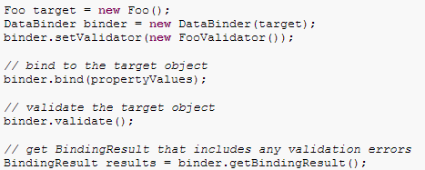
Validation
Data binding
  String → Object conversion
Validation
  after binding
  check if the result of data binding adheres our business rules
WebDataBinder
for both
(automated)

Slide 62
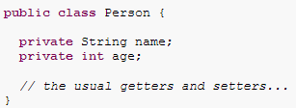
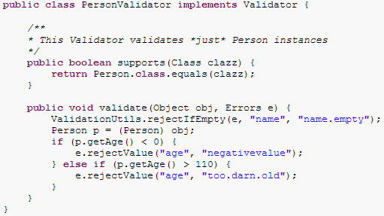
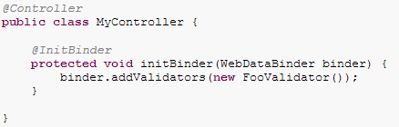
Validation
Spring proprietary validation
Notes:
You can do that, but rarely used, prefer JSR-303
Must be thread safe
org.springframework.validation.Validator (!) NOT the JSR-303 Validator

Slide 63
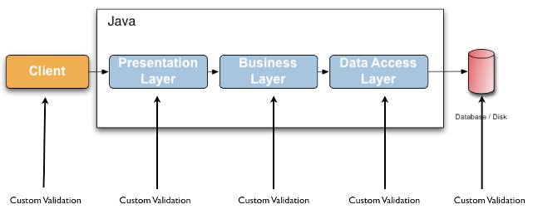
JSR-303 Bean Validation
Validation code is often duplicated or put into domain classes directly
  but it should be only a meta-data in domain classes!
Notes:
http://docs.jboss.org/hibernate/validator/4.2/reference/en-US/html_single

Slide 64
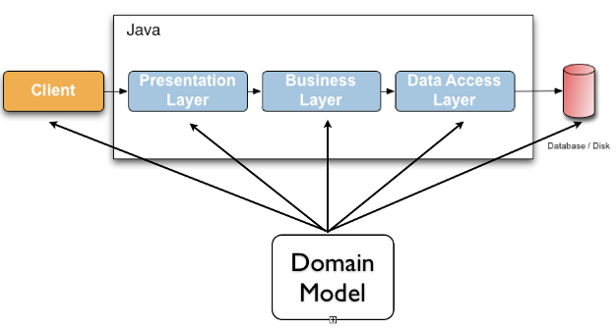
JSR-303 Bean Validation
Defines meta-data model
  annotations by default
  extensible
Not tied to a specific layer
Notes:
http://docs.jboss.org/hibernate/validator/4.2/reference/en-US/html_single

Slide 65
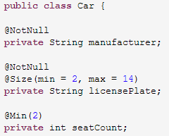
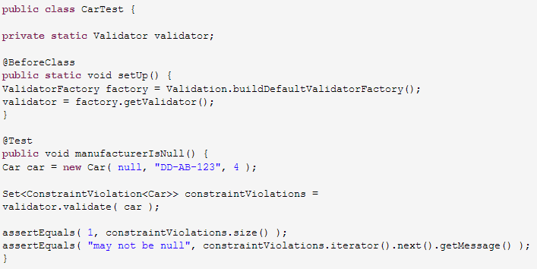
JSR-303 Bean Validation
Manual usage
Notes:
http://docs.jboss.org/hibernate/validator/4.2/reference/en-US/html_single
javax.validation.Validator; (! JSR-303)

Slide 66
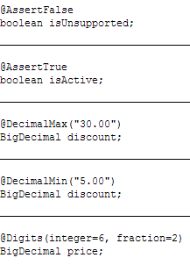
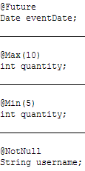
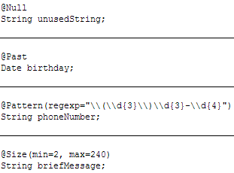
JSR-303 Bean Validation
Constraints supported by default
Notes:
http://docs.jboss.org/hibernate/validator/4.2/reference/en-US/html_single
http://docs.oracle.com/javaee/6/tutorial/doc/gircz.html
Others (like @Email) org.hibernate.validator.constraints

Slide 67

JSR-303 Bean Validation
Enable in Spring
Reference implementation
  http://docs.jboss.org/hibernate/validator/4.2/reference/en-US/html_single
Notes:
http://docs.jboss.org/hibernate/validator/4.2/reference/en-US/html_single

Slide 68


JSR-303 Bean Validation
Usage in Spring
  you can @Autowire a javax.validation.Validator
  OR let WebDataBinder validate and put the result into BindingResult
    trigger it via @Valid
Notes:
http://docs.jboss.org/hibernate/validator/4.2/reference/en-US/html_single
EA:
Enable
Perform validation of Email using @Email (hibernate specific)
Switch off client side validation
4b9311a73 Enable validation, perform email validation, switch off client side validation of email
It will fail with 400!
You have to declare a BindingResult to do not throw 400!
Check the binding results in the request scope, check the codes

Slide 69
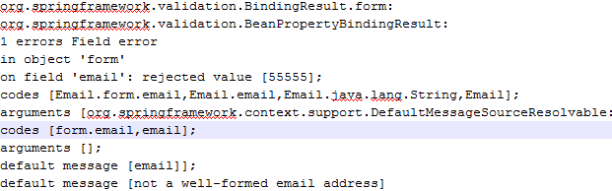
JSR-303 Bean Validation
Validation result is put to request scope
  Under key org.springframework.validation.BindingResult.[formName]
  Type org.springframework.validation.BeanPropertyBindingResult

Slide 70
JSR-303 Bean Validation
FieldError objects in result
  multiple objects may present for a field
  field is the property name for which the validation failed

Slide 71
JSR-303 Bean Validation
FieldError objects in result
  spring generated messages codes to be used as ResourceBundle (i18n) message keys (see later)
    if you want to use field specific messages
Notes:
The generated codes can be modified using custom MessageCodesResolver

Slide 72
JSR-303 Bean Validation
FieldError objects in result
  default message
    defined by the annotation
    NOT a key but the message itself
Notes:
It is still possible to use i18n for default message, it is automatically resolved by JSR303, see later
http://docs.jboss.org/hibernate/validator/4.2/reference/en-US/html_single/#section-message-interpolation

Slide 73
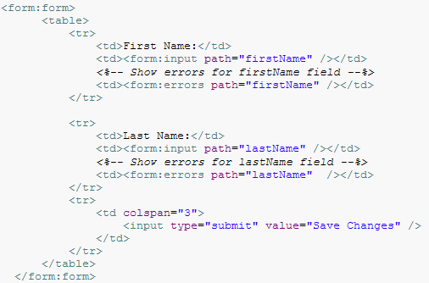
Form taglib :errors tag
Notes:
Path is the field name!
commandName has new name: modelAttribute!
<form: errors>
checks the message codes and resolves them, if nothing is found then use the default massage (already resolved)

Slide 74
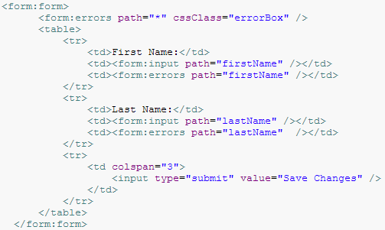
Form taglib :errors tag
Notes:
Path is the field name!
commandName has new name: modelAttribute!
<form: errors>
checks the message codes and resolves them, if nothing is found then use the default massage (already resolved)
ET:
- show the error message for email validation (both * and field)
use bootstrap alerts
EA:
- what does the form do?: expose a tag (or page) scope attribute to be used by the inner tags
http://docs.spring.io/spring/docs/3.2.8.RELEASE/spring-framework-reference/html/spring-form.tld.html#spring-form.tld.form

Slide 75
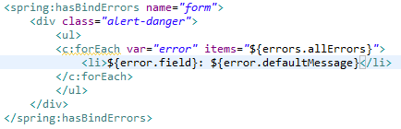
Spring taglib :hasBindErrors tag
Notes:
To list errors out of a form, usually DO NOT USE
can deal with default messages (already resolved by JSR-303)
you reach the autogenerated codes but which one to choose? You have to resolve then manually (spring:message)
use only if you know the messages codes (you generate them, see later)
EA: try it out

Slide 76
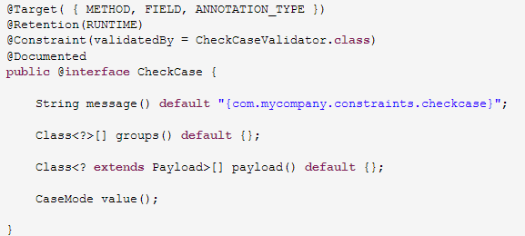
JSR-303 Bean Validation
Custom constraints - annotation
Notes:
Message can be plain text, or a key in {…}
It is resolved by the JSR-303 implementation itself (codes are resolved later by spring tags)
See later

Slide 77
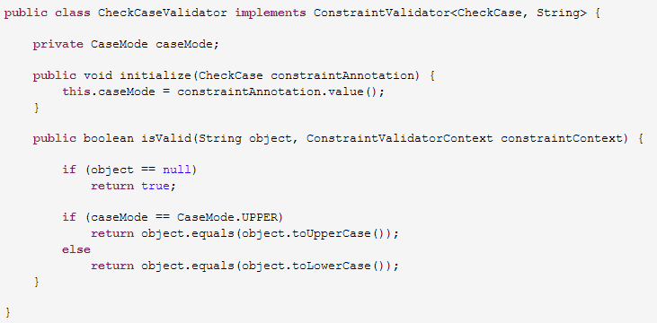
JSR-303 Bean Validation
Custom constraints - ConstraintValidator
Notes:
Must be thread safe
ET:
Create a custom @Adult annotation for the birthday
Use a simple default massage (NOT a key)
EA:
- Rename to @AgeRange and enhance with „value” (children, tinager, adult)

Slide 78
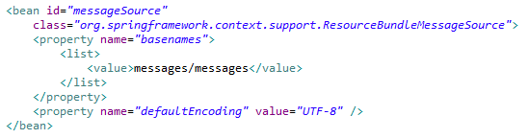
Error message i18n
Reminder: Spring i18n

Slide 79
Error message i18n
Default message
  defined by ValidatorConstraint
  if it is in {…} then JSR-303 implementation tries to resolve it
    „ValidationMessages.properties” on the classpath root
    same file in the implementation jar
Notes:
http://docs.jboss.org/hibernate/validator/4.2/reference/en-US/html_single/#section-message-interpolator
Check the jar to see from where the default comes

Slide 80
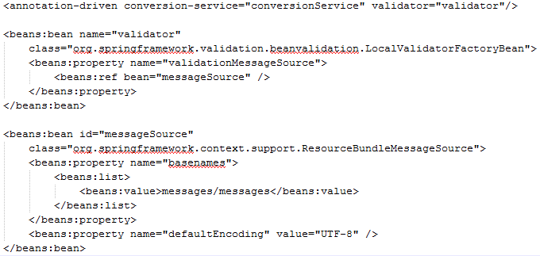
Error message i18n
Default message
  set JSR-303 to use our Spring messageSource instead
Notes:
http://docs.jboss.org/hibernate/validator/4.2/reference/en-US/html_single/#section-message-interpolator
We define the validator manually instead of letting the <annotationdriven> do it
EA:
Enable Spring i18n
Use a key in @Adult instead of plain text
Define messages for it

Slide 81
Error message i18n
Generated „codes”
  for field specific or global (when you add your own error objects) errors
  for i18n resolution
  generated by Spring’s MessageCodeResolver
    customizable if you want
  Resolved by <form:errors>
Notes:
ET:
Add validation for all fields
Add custom messages for all fields
See how default messages are ignored…
Except hasBindErrors… just delete it (has its use but we do not care now)
EA
See what happens if the binding (the Formatter) fails for a Date (add custom message for that as well)

Slide 82
General i18n
<spring:message code=„…”> tag
Notes:
EA: try it in the title or somewhere else

Slide 83
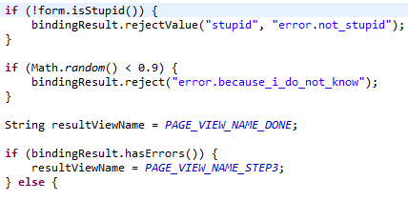
JSR-303 Bean Validation
Custom errors (not added by validation)
  for fields
  general
    use <form:errors > without „path” to show only these

Slide 84
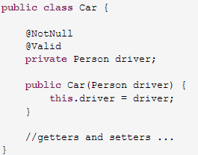
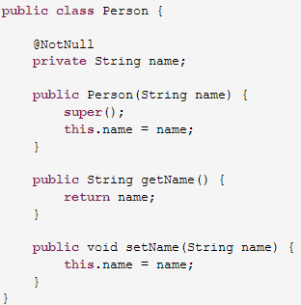
JSR-303 Bean Validation
Object graph validation
  for recursive validation
  also works for arrays, Iterable, Maps

Slide 85
Form tag library
form tag to specify form object („modelAttribute” or the old „commandObject”)
errors tag (already covered)
HTML form element renderer tags
  aware of the form object in the request/session scope
    read data from it if it exists and render the HTML element accordingly
    uses Spring’s Formatter SPI when printing out values from model
    target field can be specified directly instead of manually adding HTML „name” (use „path”)
  checkbox,checkboxes,hidden,input,label,option,optionspassword,radiobutton,radiobuttons,select,textarea
  supports all HTML attributes
Notes:
http://docs.spring.io/spring/docs/3.2.8.RELEASE/spring-framework-reference/html/view.html

Slide 86
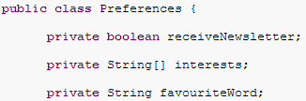
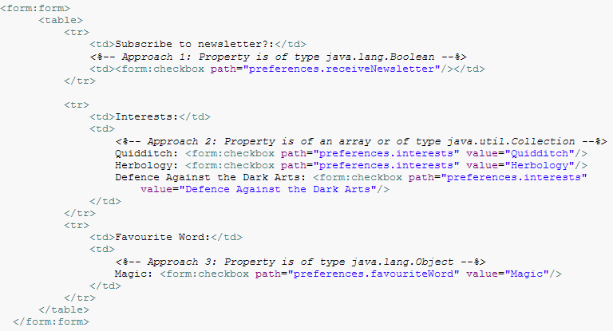
Form tag library
Notes:
http://docs.spring.io/spring/docs/3.2.8.RELEASE/spring-framework-reference/html/view.html
Default modelAttribute name: „command”, bad practice
„preferences.” means an inner object in the form object
Approach One - When the bound value is of type java.lang.Boolean, the input(checkbox) is marked as 'checked' if the bound value is true. The value attribute corresponds to the resolved value of the setValue(Object) value property.
Approach Two - When the bound value is of type array or java.util.Collection, the input(checkbox) is marked as 'checked' if the configured setValue(Object) value is present in the bound Collection.
Approach Three - For any other bound value type, the input(checkbox) is marked as 'checked' if the configured setValue(Object) is equal to the bound value.

Slide 87
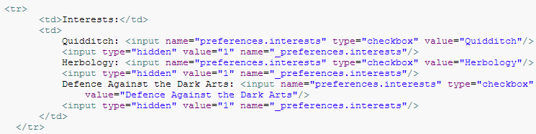
Form tag library
hidden form elements
  browsers do not send anything if a checkbox is not checked
  this way we can say „it was shown, please consider”
Notes:
http://docs.spring.io/spring/docs/3.2.8.RELEASE/spring-framework-reference/html/view.html

Slide 88

Form tag library
Array, List supported
  checkbox „value”s
Map is supported
  key:checkbox „value”s
  value:label
Notes:
http://docs.spring.io/spring/docs/3.2.8.RELEASE/spring-framework-reference/html/view.html

Slide 89


Form tag library
„code” and „name” are properties
Notes:
http://docs.spring.io/spring/docs/3.2.8.RELEASE/spring-framework-reference/html/view.html
ET:
refactor the current wizard
EA
Implement country selector
Implement a multi checkbox, stored in Enum list

Slide 90
Form tag library
http://docs.spring.io/spring/docs/3.2.8.RELEASE/spring-framework-reference/html/view.html

Slide 91


Form tag library
HTTP method conversion
  browsers support only GET and POST as form „method” (not enough for REST APIs)
  a hidden „_method” parameter is added to the form by the tag and interpreted by a filter
Notes:
Will try it out later

Slide 92


ViewResolvers
Translate
  logical view names
  to view Views that handle the rendering itself
Notes:
Class+URL (in case of JSP) = View
If you use JSTL (very likely) then use JstlView (requires special handling)

Slide 93

ViewResolvers
ViewResolver chaining
Notes:
InternalResourceViewResolver is always the last in the chain

Slide 94

ViewResolvers
Delagates to other ViewResolvers
Notes:
0. BeanNameViewResolves treat view names as bean names (if view name is „content” then the AtomView is returned with id „content”)
0. Views know which content type they support (see org.springframework.web.servlet.View)
0. „mediaTypes” is needed only if we want to consider extension/request parameter based content type resolution
Otherwise „Accept” request header is used (not a good idea because in browser it is set and hard or can not be set)
A „view name” comes in (e.g. „content”)
„requested content type” is determined by Accept header or extension, or special parameter
ContentNegotiatingVR consults with the listed ViewResolvers (one by one) if they can resolve the „view name”
if one can resolve then the View’s content type is checked if it is „requested content type”
if it is not, then the next ViewResolver is asked to resolve the view name, etc.
If all VRs have failed then defaultView list is checked one by one
here only the „requested content type” matters (view name can be resolved by VRs and they have failed)
it means that defaultViews can not depend on view names (they are just generators usually that do not care the view name)
EA:
Create a JSON and an RSS view
no BeanNameResolver is required
avoid using depracated „mediaTypes” (good to show to concept in one page ☺)
https://spring.io/blog/2013/05/11/content-negotiation-using-spring-mvc
<link rel="alternate" type="application/rss+xml" title="Omen RSS" href="http://localhost:8080/omen/endofworld/?century=20&mediaType=rss" />
Install Chrome plugin to see it :S
<dependency>
<groupId>com.fasterxml.jackson.core</groupId>
<artifactId>jackson-core</artifactId>
<version>2.2.3</version>
</dependency>
<dependency>
<groupId>com.fasterxml.jackson.core</groupId>
<artifactId>jackson-databind</artifactId>
<version>2.2.3</version>
</dependency>
-http://www.mkyong.com/spring-mvc/spring-3-mvc-and-rss-feed-example/
http://www.mkyong.com/spring-mvc/spring-3-mvc-and-json-example/

Slide 95
Other natively supported Views
Tiles
Velocity & Freemarker
XSLT
PDF/Excel
Feeds
XML

Slide 96

Avoid „form resubmission”
Problem
  If a POST (non-idempotent) handler method returns a view name after success normally it means a „forward” to that JSP (the browser know nothing about it)
  The user can „refresh” → leads to form resubmission

Slide 97
Avoid „form resubmission”
Use Get/Post/Redirect/Get cycle
  a GET handler shows the empty (or prefilled) form
  a corresponding POST handler
    Validates the submitted results
      Success
        send redirect to another page („done”, or next page of a multi page form)
        browser GETs that page
      Failure
        use forward (return viewname, but it will cause the same problem)
        OR redirect back to the form’s GET page
          you must store the errors in the session in this case
Notes:
This cycle is for each form page

Slide 98
Avoid „form resubmission”
Controller can initiate redirect returning
  a RedirectView
    bad idea because Controllers are supposed to work with logical view names, for View resolution we have ViewResolvers
  „redirect://[URL]”
    effectively it is resolved to a RedirectView
Notes:
ET:
Refactor our EOW report to use this principle
In case of errors just use the forward
Remaining problems:
If there is an error in step 2 and i go back to step 1 and try to post → validation of step 2 happens :S
remove the elements in step 2 posts in case of errors (good for us for now)
use JSR-303’s group validation (out of scope)

Slide 99
Avoid „form resubmission”
How can we keep our request attributes after a redirect?
  by default the RedirectView puts ALL request scope attributes into the URL
    with RedirectAttributes you can control which ones
    BAD idea, just disable
Notes:
ET:
- Try and disable

Slide 100
Avoid „form resubmission”
How can we keep our request attributes after a redirect?
  by default the RedirectView puts ALL request scope attributes into the URL
    with RedirectAttributes you can control which ones
    BAD idea, just disable
  @SessionAttributes
    you have to handle the put/removal manually
  RedirectAttributes

Slide 101
LocaleResolver

Slide 102
ThemeResolver

Slide 103
Resource serving

Slide 104
Exception handling

Slide 105
Web specific bean scopes
  With or without Spring MVC

Slide 106
Interceptors

Slide 107
RESTful API with Spring MVC

Slide 108


Controllers
@RequestMapping – URI templates
Notes:
@PathVariable:
binding result and value itself are put into the request scope but NOT into the Model
Strange because usually request is populated from Mode
form objects are put into Model (hence to request scope)
others @RequestParam, @RequestHeader are NOT put to anywhere… so @PathVariable is unique somehow

Slide 109
Controllers
@RequestMapping – URI templates
  regexp support
    {varName:regex}
  ant-style path support
  ${…} placeholder support
    via PropertyPlaceHolderConfigurer
  @PathVariable Map<String,String>
    collects all the variables in a map

Slide 110


Controllers
@RequestMapping – matrix variables
  a new concept to pass additional refinement attributes to a single value in REST-like URLs
Notes:
http://www.w3.org/DesignIssues/MatrixURIs.html

Slide 111
Spring Security basics

Slide 112
Controllers
Asynchronous request processing

Slide 113
File upload

Slide 114
Controllers
@ControllerAdvice

Slide 115
Convention over configuration

Slide 116
Books and other useful references
Spring in Action
  most well-known
  touches many things but far from being exhaustive
  http://www.amazon.com/Spring-Action-Craig-Walls/dp/1935182358/ref=sr_1_3?ie=UTF8&qid=1391418399&sr=8-3&keywords=spring
Spring in Practice
  a more practical approach (read it only after Spring in Action)
  http://www.amazon.com/Spring-Practice-Willie-Wheeler/dp/1935182056/ref=sr_1_1?ie=UTF8&qid=1391418399&sr=8-1&keywords=spring
Spring Reference
  you’ll end up here eventually… ☺
  http://docs.spring.io/spring/docs/3.2.6.RELEASE/spring-framework-reference/html/
  JavaDoc of main annotations, classes ☹ (DO NOT FORGET!)

Slide 117
Homework
Take the fantasy world created in our last session „Web basics, Servlet & JSP API” OR A NEW and transform it to a Spring MVC application
  use as many concept you learned during the training as you reasonably can
  try to use patterns/solutions as you would use in a real application
  (our current one may contain improper ones for the sake of the presentation)
Share the result with me using git
Have fun, and surprise me with the result ☺

